Slide 1
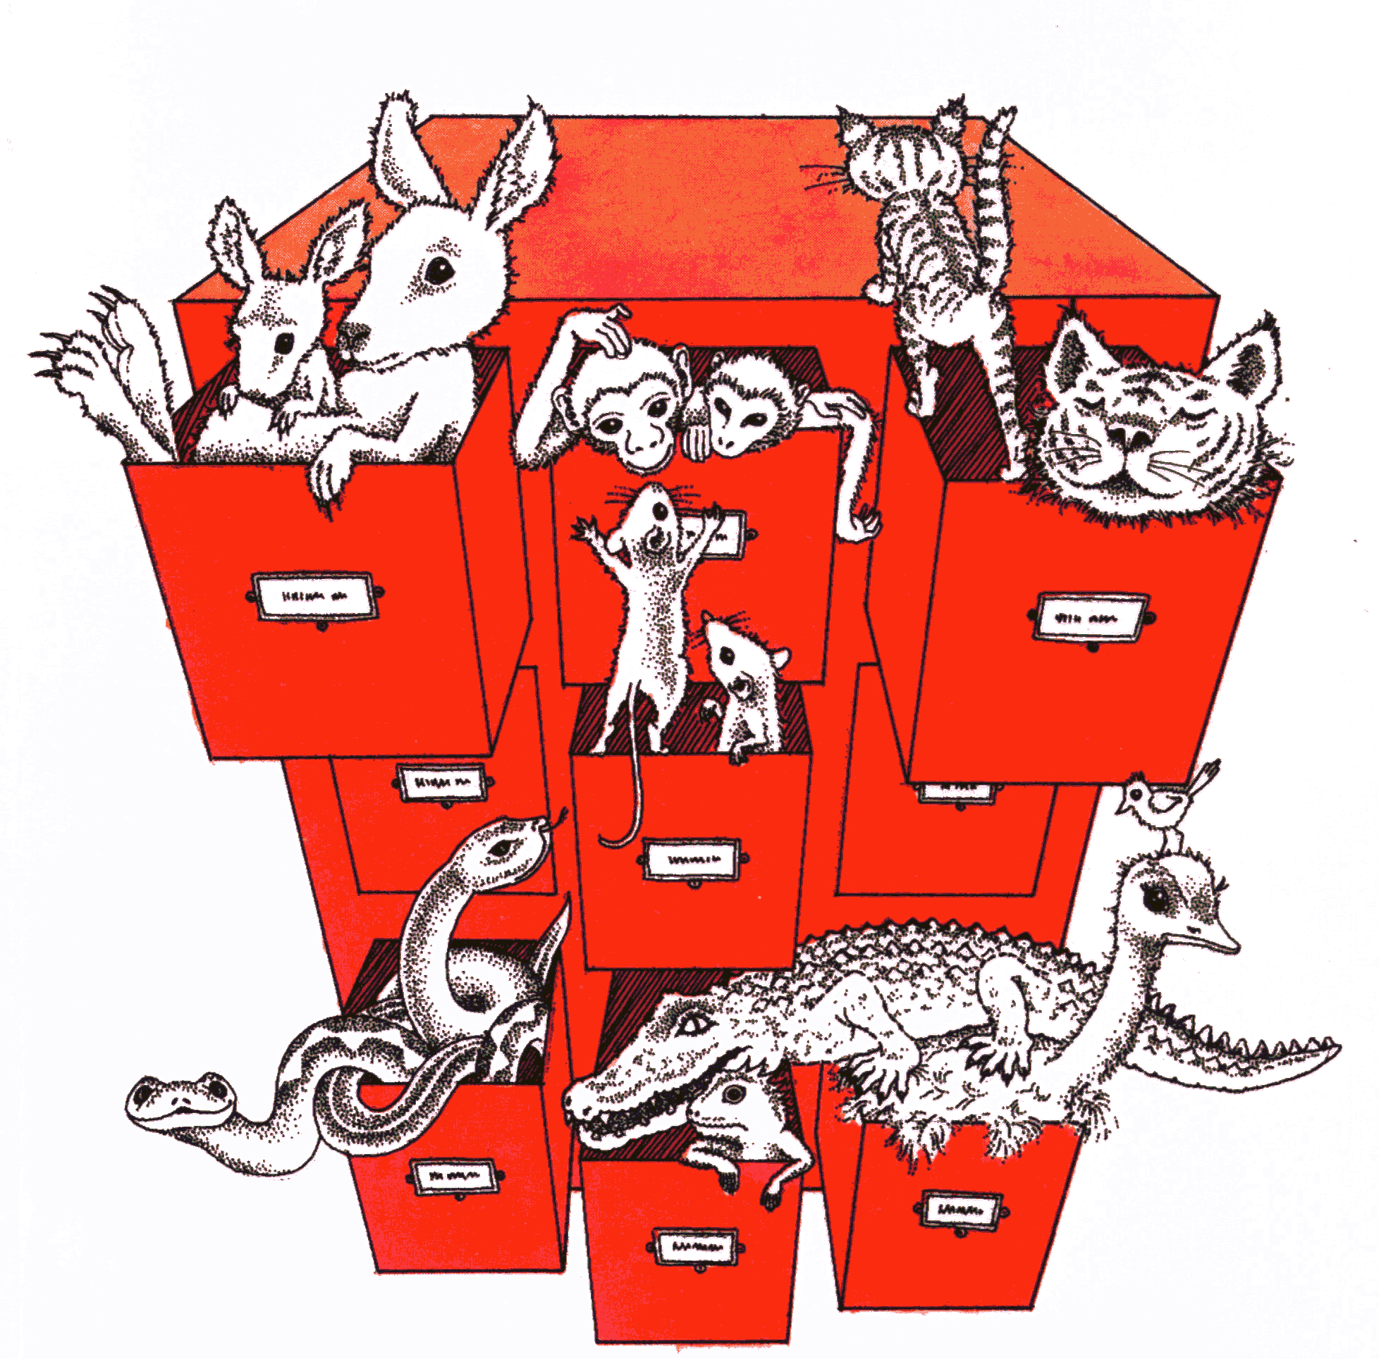
Taxonomy

Slide 2
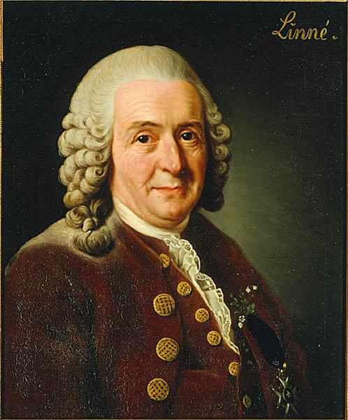
Linnaeus
Notes:
2007 was 300th anniversary of his birth

Slide 3
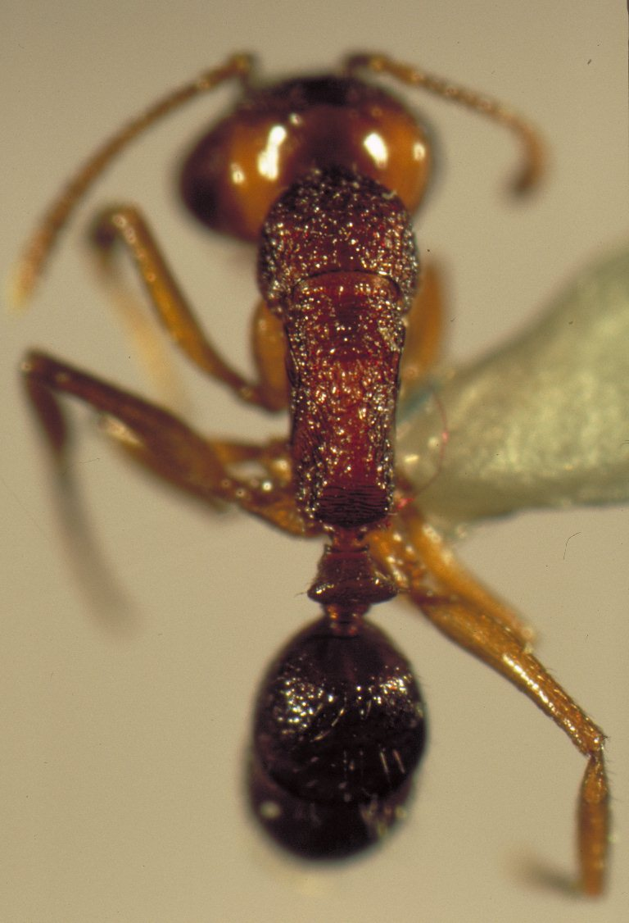
ヒメアギトアリ（Anochetus shohki）の画像一覧

Slide 4
Fun with Latin
Abra cadabra (abracadabra)
Ba humbugi (ba humbug)
Eurygenius (you're a genius)
Gelae baen (jelly bean)
Heerz lukenatcha (here’s lookin' atcha)
Pieza kake (piece a cake)
Ytu brutus (et tu Brutus)

Slide 5
Scatological fun with Latin
Bugeranus
Doryctes fartus
Dyaria
Eremobates inyoanus
Pison eu
Soranus

Slide 6
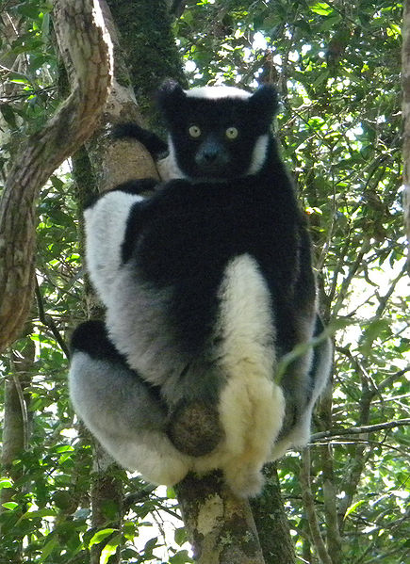
Indri indri
Often claimed name means “look!” or “there” in Malagasy
(story is more complicated, see Wikipedia page http://en.wikipedia.org/wiki/Indri )

Slide 7
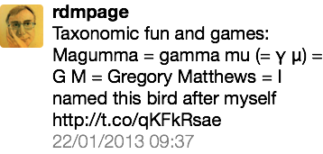
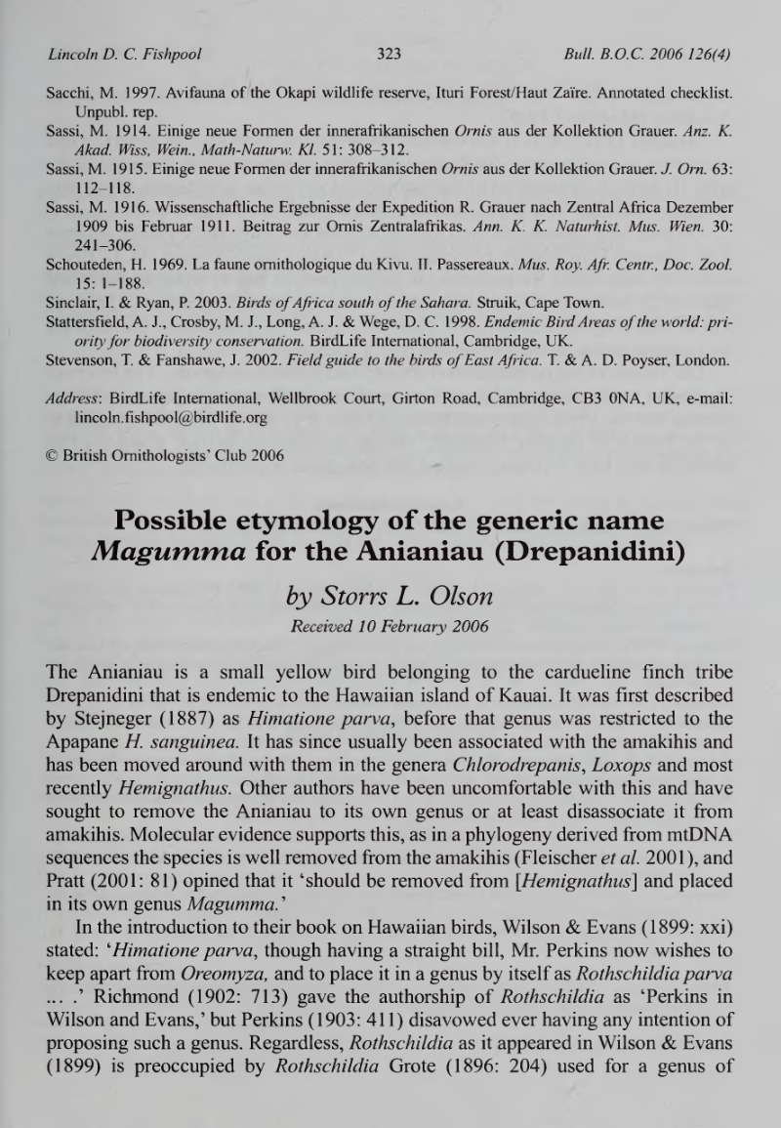
You are not supposed to name an organism after yourself…
Notes:
http://biostor.org/reference/111737

Slide 8
Nomenclature has inherited a quaint view of the tree of life

Slide 9
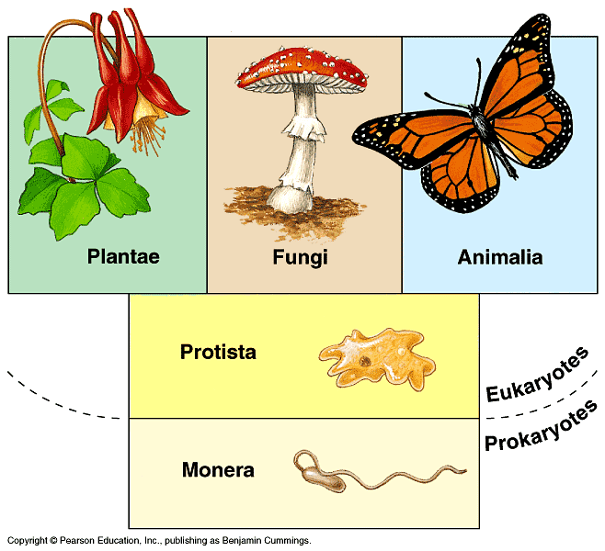
Notes:
Coverage is not universal (ironically), different codes, leads to homonyms (give examples, e.g. Morus, Agathis montana,) Mention web sites that suffer from these problems

Slide 10
Animals (International Code of Zoological Nomenclature)

Slide 11
Plants and Fungi (International Code of Botanical Nomenclature)

Slide 12
Bacteria (International Code of Nomenclature of Bacteria)

Slide 13
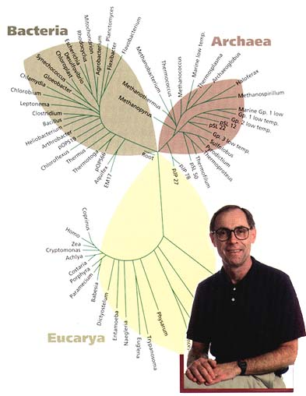
Evolutionary tree for all of life
Constructed from ribosomal RNA sequences

Slide 14
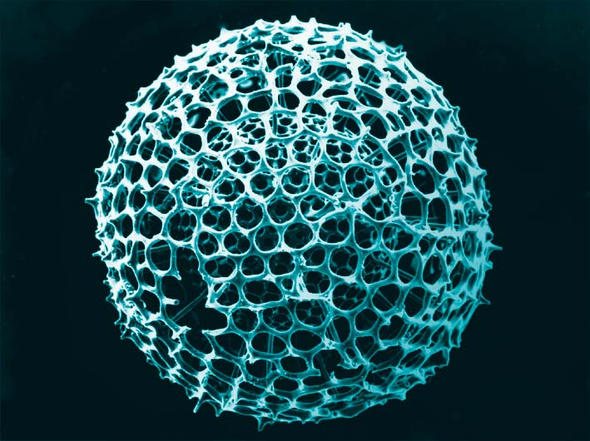
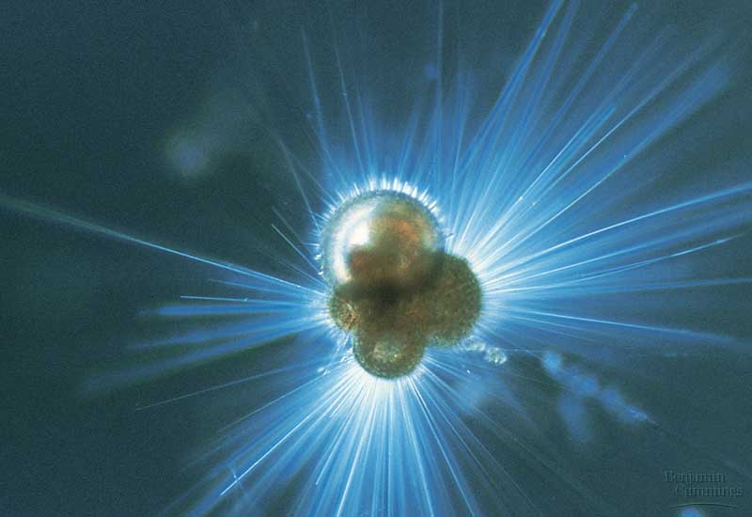
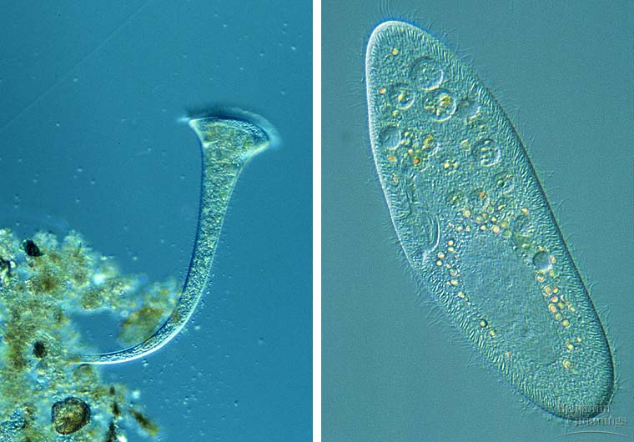
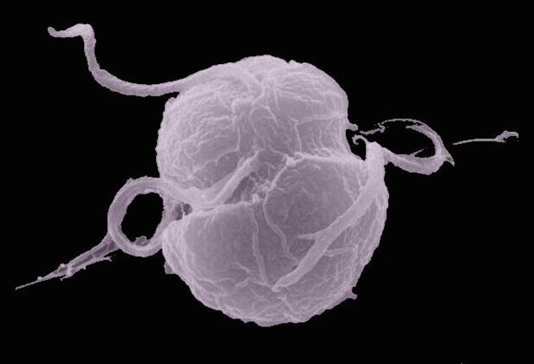
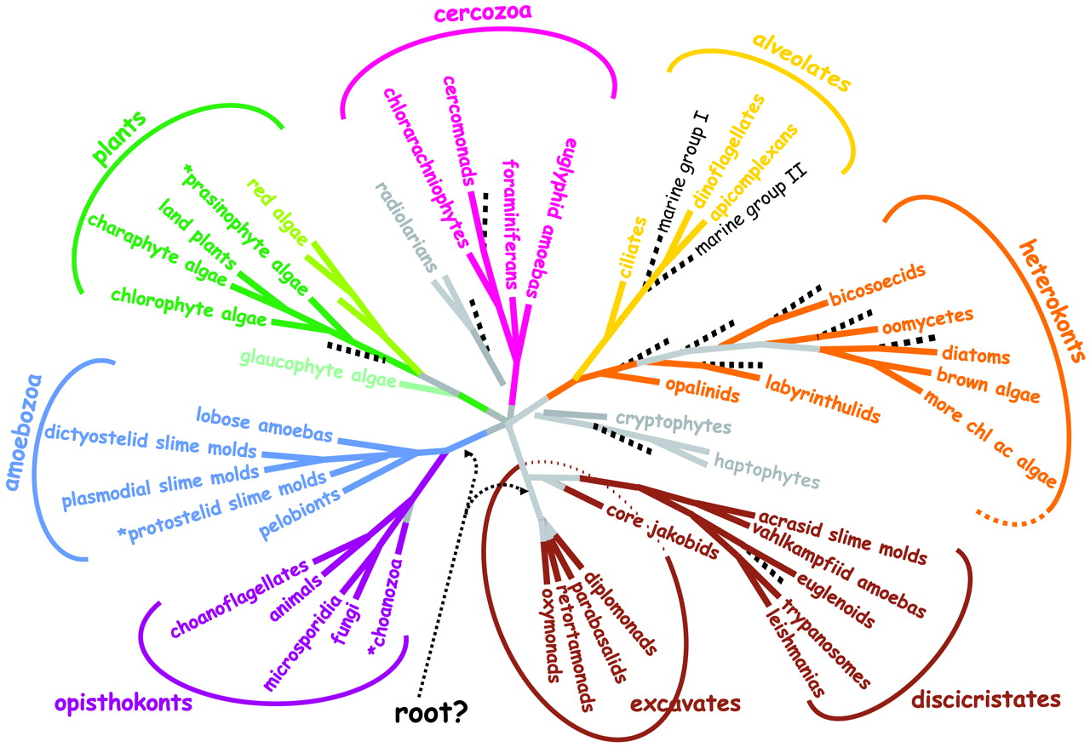
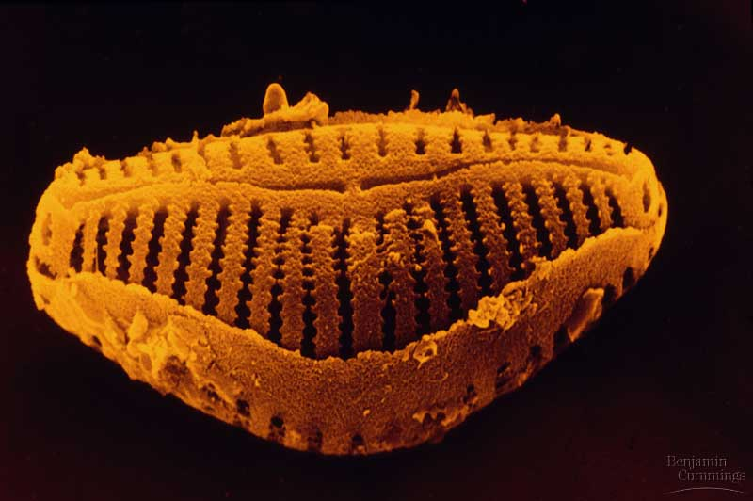
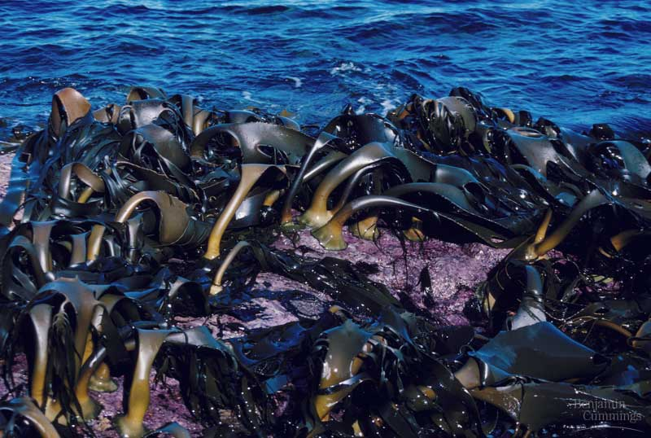
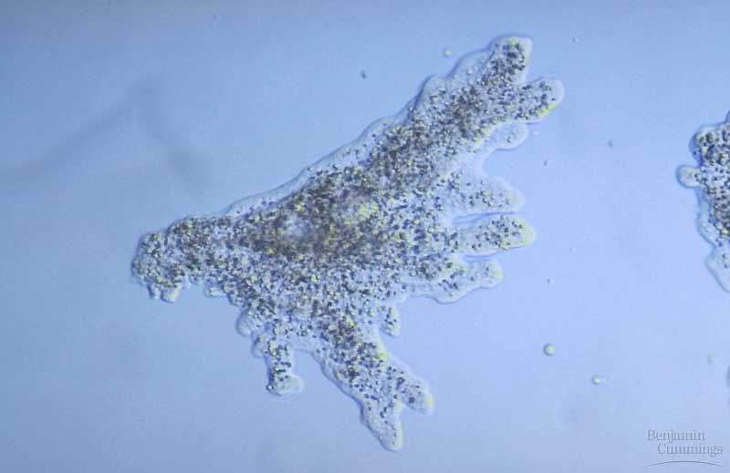
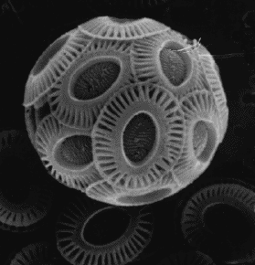
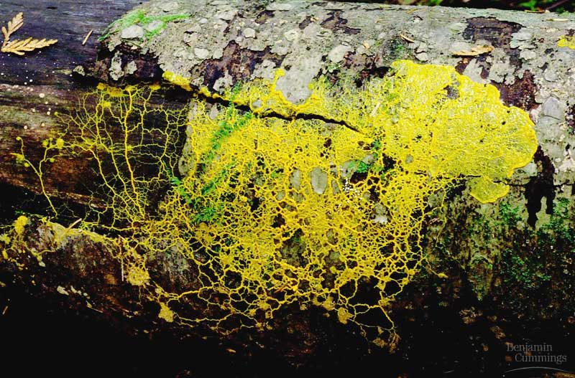
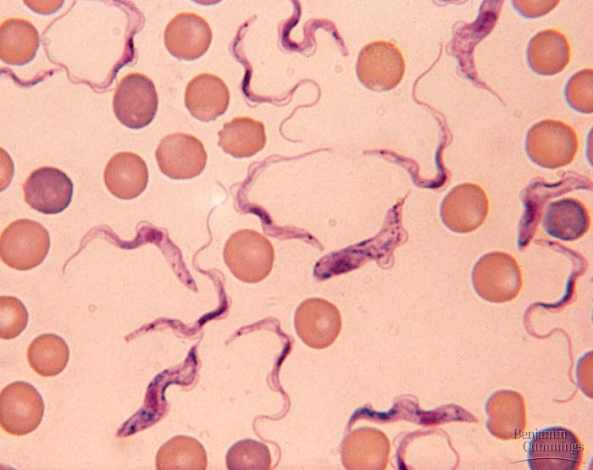
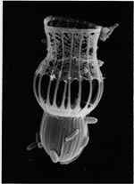
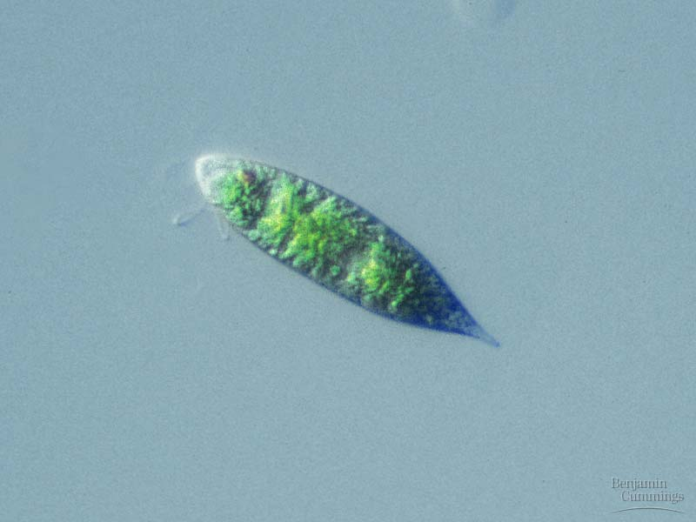
Unikonts
Bikonts
The Deep Roots of Eukaryotes, S. L. Baldauf, Science Jun 13 2003: 1703-1706
Notes:
Unikots, unicellular and free-living multicellular organisms all have one flagellum, biokonts have two (note that Euglena has two, one small, one large)

Slide 15
Fungi can could have two names (anamorph and telomorph)
Anamorph is asexual phase,
telomorph is sexual stage
[DNA makes it possible to match the two]
Notes:
With the Melbourne 2011 code fungi will have a single name

Slide 16
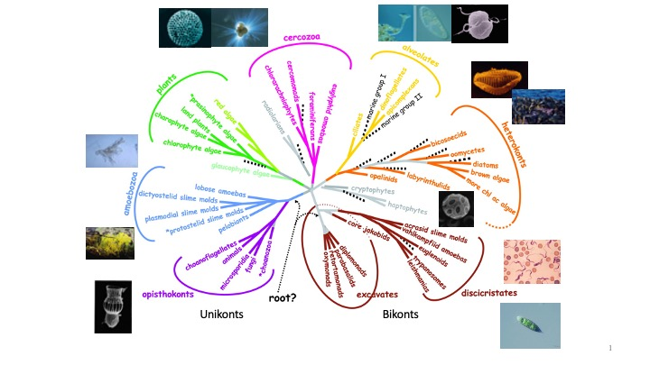
“Protists” (animal, plant, or both?) (= ambiregnal organisms)

Slide 17
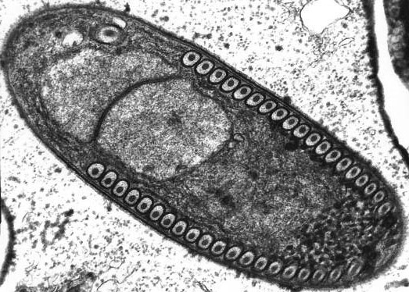
Microsporida
Originally regarded as protists and named under zoological code, they are now known to be fungi, but will remain under zoological rules for naming.

Slide 18
Homonyms (ideally names should be unique)
Paris, Texas

Slide 19
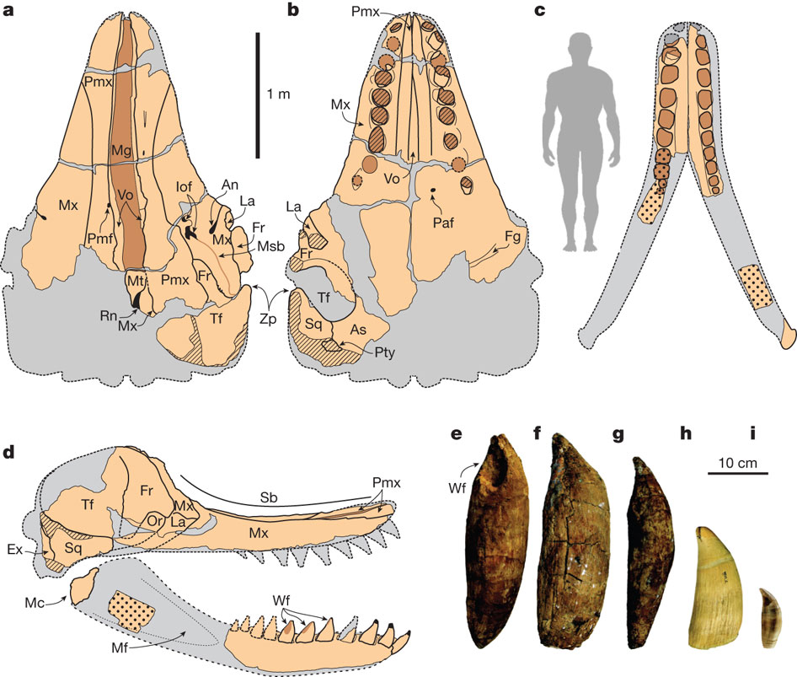

Skull, mandible and tooth morphology of the holotype of L. melvillei MUSM 1676.
O Lambert et al. Nature 466, 105-108 (2010) doi:10.1038/nature09067

Slide 20
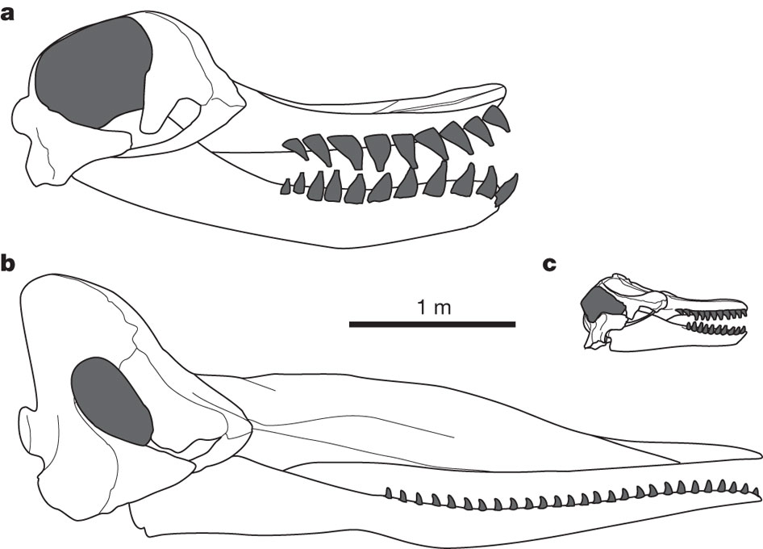

Slide 21
Leviathan melvillei

Slide 22
But Leviathan had already been used as a genus name…

Slide 23
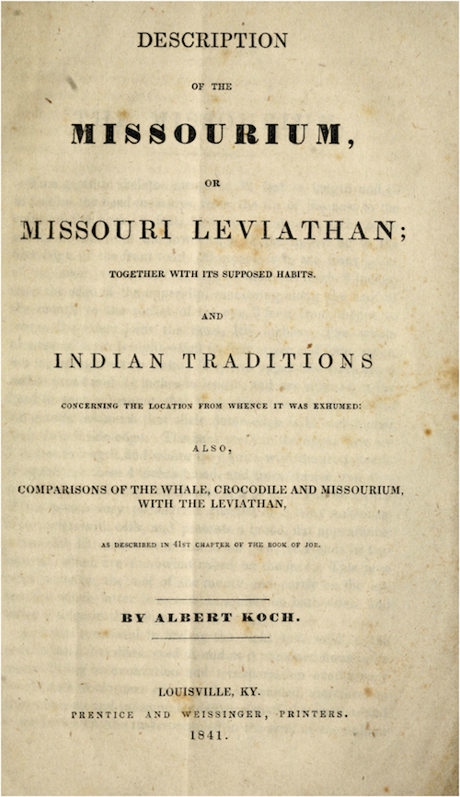

Slide 24
Oops…

Slide 25
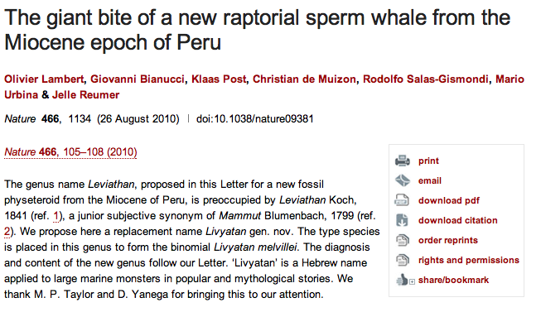
Leviathan melvillei

Slide 26
Livyatan melvillei

Slide 27
Why homonyms matter

Slide 28
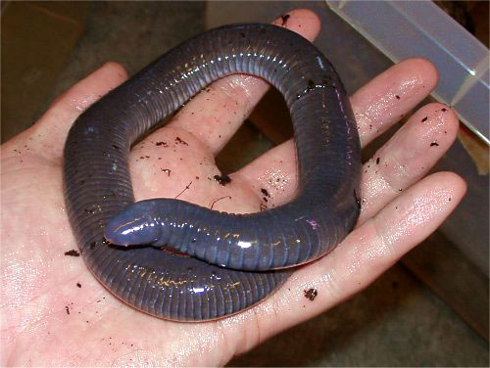
Caeciliidae

Slide 29
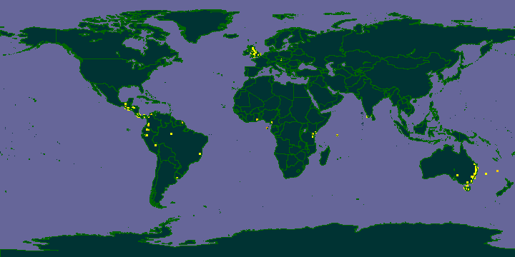
Search GBIF in 2008 for “Caeciliidae”
Notes:
Homonym, see http://www.ncbi.nlm.nih.gov/Taxonomy/Browser/wwwtax.cgi?mode=Info&id=159975&lvl=3&lin=f&keep=1&srchmode=1&unlock name in insects has been suppressed since 1996

Slide 30
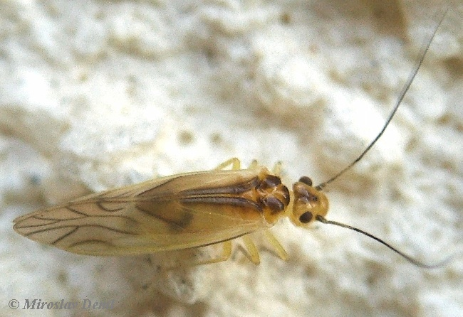
Caeciliidae
Notes:
Homonym, see http://www.ncbi.nlm.nih.gov/Taxonomy/Browser/wwwtax.cgi?mode=Info&id=159975&lvl=3&lin=f&keep=1&srchmode=1&unlock name in insects has been suppressed since 1996

Slide 31
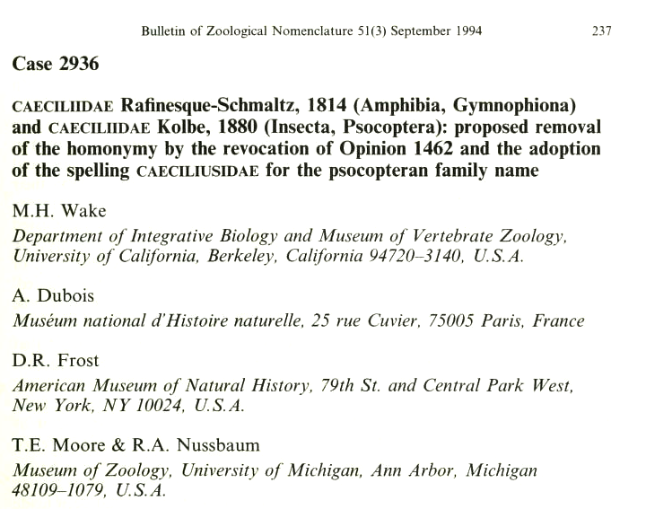
Types of synonym
http://biostor.org/reference/17

Slide 32
Hemihomonyms
Same name, different code

Slide 33
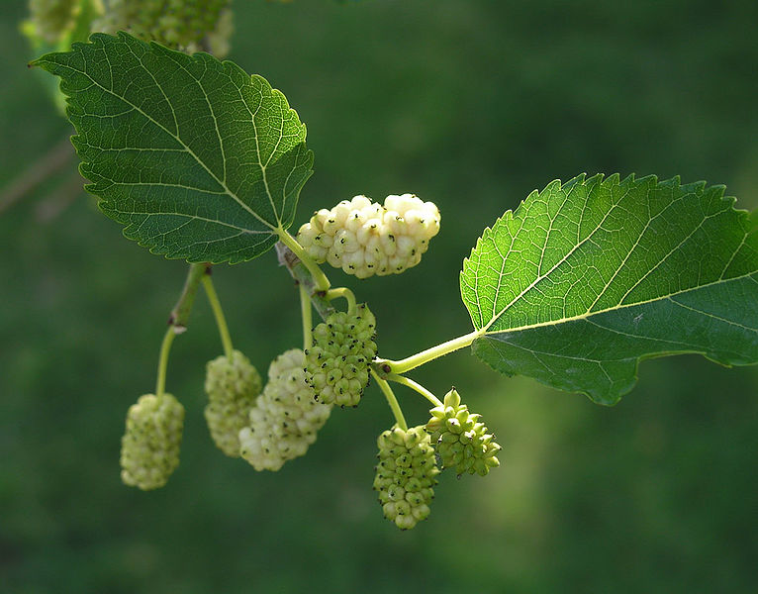
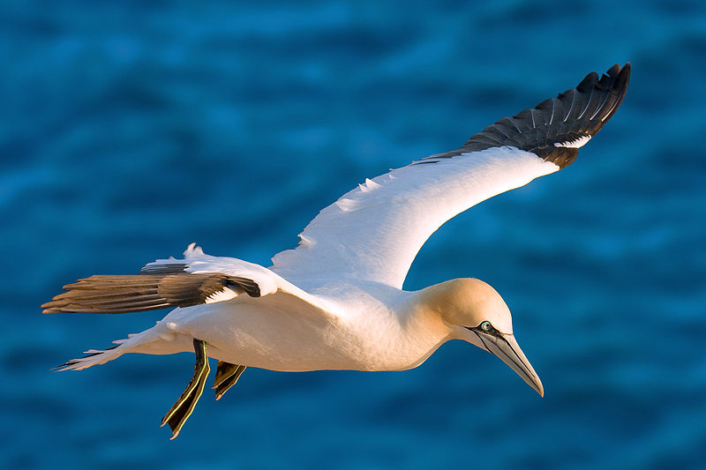
Morus
Mulberry tree
Gannet

Slide 34
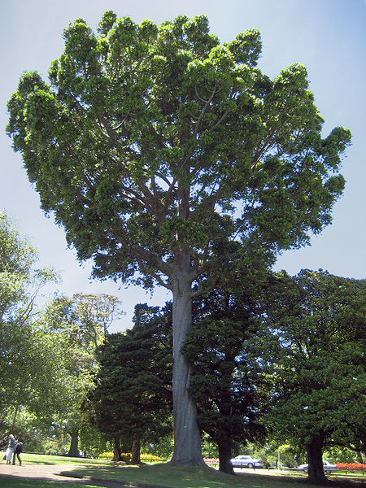
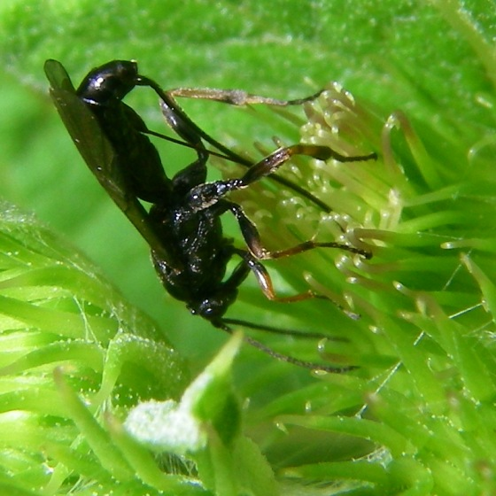
Agathis

Slide 35
Some plant and animal species have the same name
Agathis montana (tree and wasp)
Abronia aurita (plant and lizard)

Slide 36
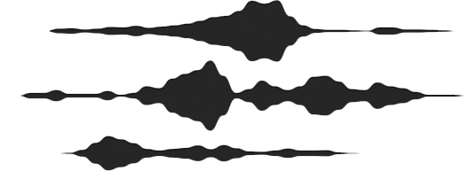
Synonyms

Slide 37
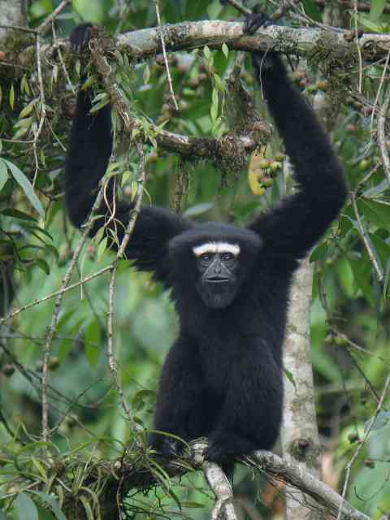
Notes:
http://www.birding2asia.com/InFocus/WesternHoolockGibbon.html

Slide 38
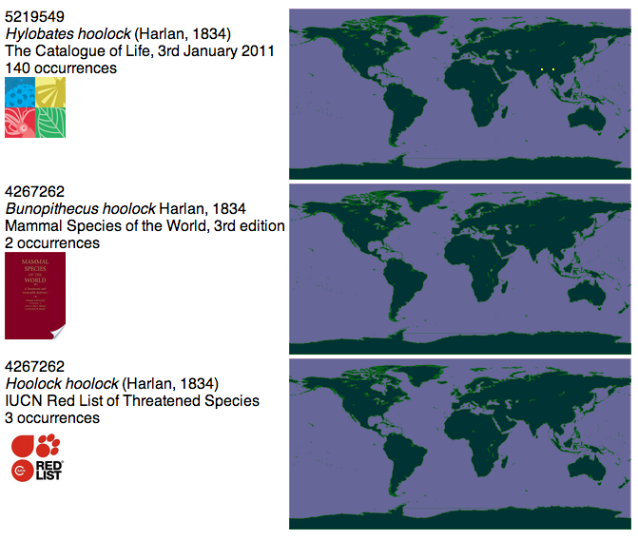

Slide 39
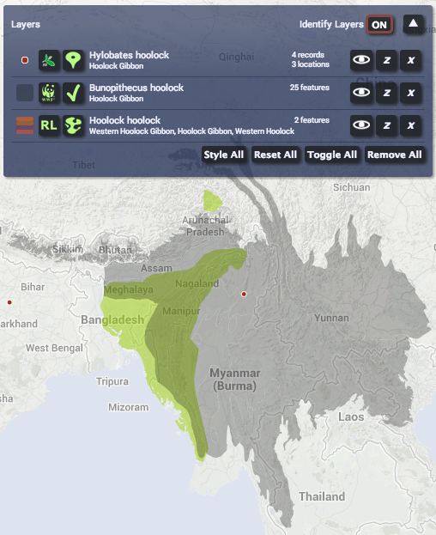

Slide 40
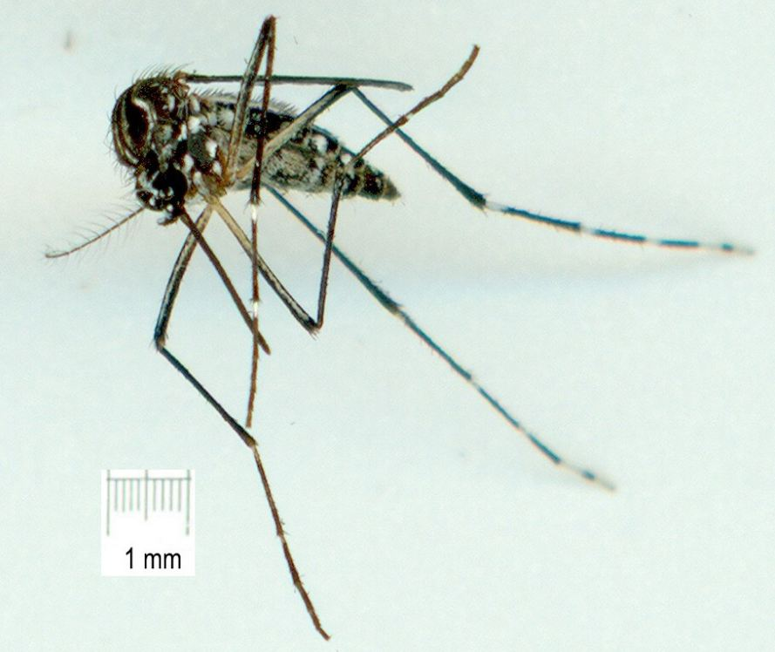
Stegomyia aegypti (yellow fever mosquito)

Slide 41
Google searches give different results depending on name
Stegomyia aegypti 50,600
Aedes aegypti 1,390,000
Culex aegypti 469,000

Slide 42


Slide 43

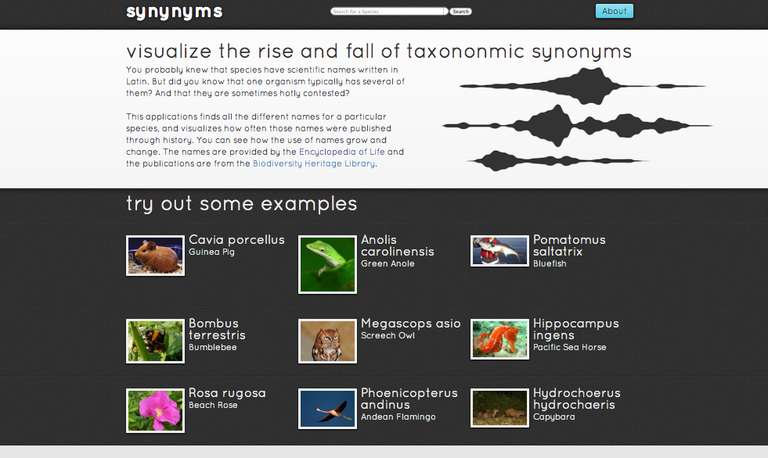
http://synynyms.no.de/
@ryanschenk

Slide 44


All your base after 1923 are belong to us

Slide 45
Why do names change?

Slide 46
Opaque identifiers (you shouldn’t infer anything about an object based on its identifier)

Slide 47
58D31D52-713D-44B4-9FE9-CB2D9249C422 versus Homo sapiens

Slide 48
Opacity is a nice idea
Fundamental axiom of the web, but…
We invest identifiers with meaning (even if we “shouldn’t”)
In practice we rely on parsing identifiers (I trust “google.com” more than “givemeyourcreditcardnumberquick.com” )
Opacity ≠ obscurity (human readable identifiers not necessarily bad)

Slide 49
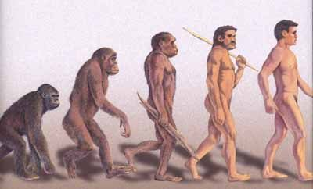
Taxonomic names can indicate relationship, and can be descriptive
Homo sapiens Linnaeus 1758
(modern man)
Homo neanderthalensis King, 1864 (Neanderthal man)
Homo erectus (Dubois, 1892)
(upright man)
Pan troglodytes (Blumenbach, 1775)
(chimpanzee)

Slide 50

Names can tell us about relationships
Cherie Booth

Slide 51

Name changes matter
Cherie Booth
Cherie Blair

Slide 52

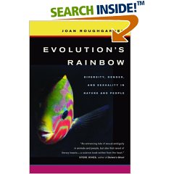

Name changes matter
Jonathon Roughgarden =
Joan Roughgarden

Slide 53
One reason taxonomic names change is because we invest them with meaning (they are not opaque identifiers)

Slide 54
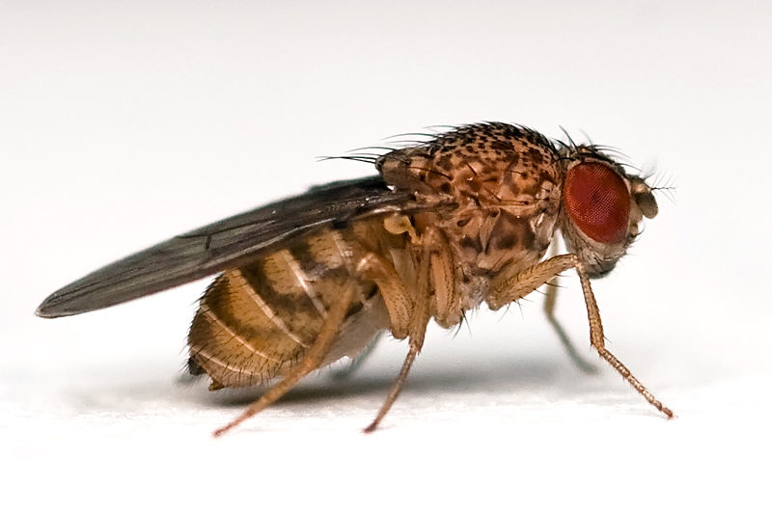
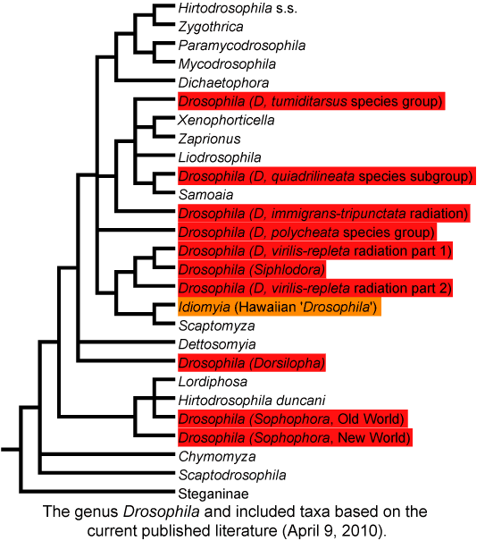
Drosophila

Slide 55
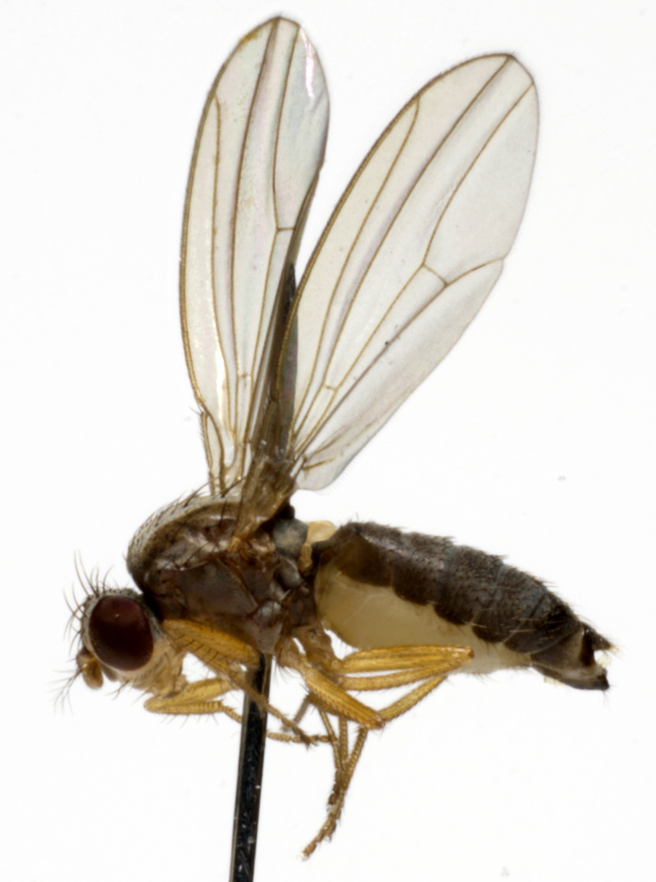
Type specimen
Species
name
Notes:
http://diptera.info/forum/attachments/jf09-0798.jpg

Slide 56
Type species
Genus
name
Drosophila
Drosophila funebris
Notes:
http://diptera.info/forum/attachments/jf09-0798.jpg

Slide 57
Drosophila
Drosophila funebris
Drosophila melanogaster

Slide 58
How do make Drosophila taxonomy fit the tree?
Make everything Drosophila
Big genus, have to rename lots of species
Restrict Drosophila to a monophyletic group that includes the type species (D. funebris)
Drosophila melanogaster can’t be Drosophila melanogaster
Change the type species to Drosophila melanogaster
But nomenclature is not taxonomy

Slide 59
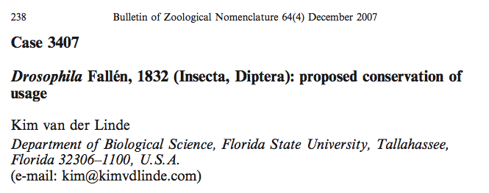
Asked ICZN: Can we change type species of Drosophila?

Slide 60
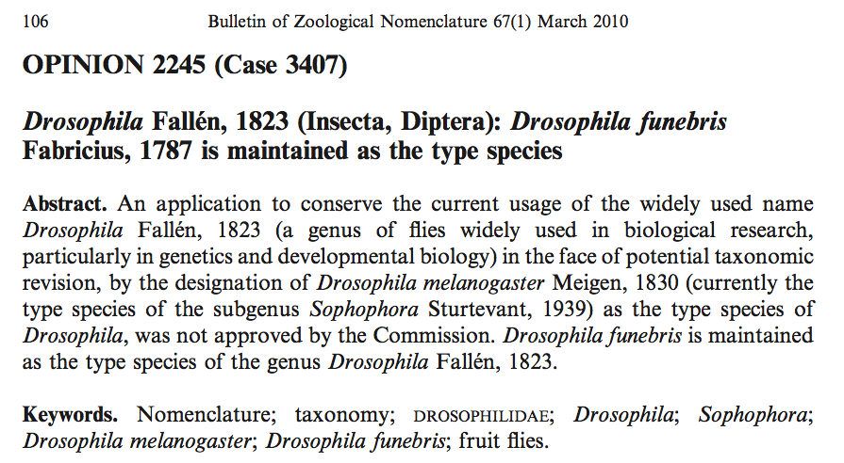
ICZN says “no”

Slide 61
Problem is premise that names have to match tree
Drosophila funebris
Drosophila melanogaster

Slide 62
Types of synonym

Slide 63
Objective (no biology required)

Slide 64
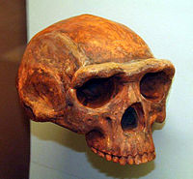
Pithecanthropus erectus Dubois, 1894 = Homo erectus (Dubois, 1894)

Slide 65
Subjective (biology required)

Slide 66
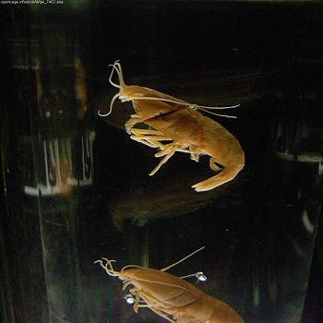


Iorania concordia & Rimicaris aurantiaca = Rimicaris exoculata
Genetic data show small, orange, deep-vent shrimps described as new species are actually juvenile Rimicaris exoculata

Slide 67
Classification
( ≠ phylogeny)

Slide 68
Classification can be contentious

Slide 69

Figure 32.12 Comparing the molecular based and grade-based trees of animal phylogeny

Slide 70



Coelomata (we should be looking at flies)
Coelomata
(true body cavity)

Slide 71
Ecdysozoa (flies and nematodes are both OK)
Ecdysozoa

Slide 72


Slide 73


Slide 74
Viewing classifications

Slide 75

http://treevis.net

Slide 76


Slide 77

Voroni treemap

Slide 78


Slide 79


Slide 80


Slide 81
Taxonomy without names

Slide 82

Barcodes
Only a few numbers needed to generate unique identifiers
e.g., 10 × 10 ×10 × 10 × 10 × 10 = 1,000,000

Slide 83
DNA barcode
cctgta
4 × 4 × 4 × 4 × 4 × 4 = 4096

Slide 84
DNA as a biological barcode
Sequence the same stretch of DNA in all animals
Quickly know whether sequence is new or not (compare with all known sequences)
Get some idea of what unknown species is (e.g., it’s like fly DNA)
Already used in microbiology and forensic zoology (e.g., whale meat)

Slide 85


DNA barcode for Calidris alpina (Dunlin)

Slide 86


Slide 87

Chilean blob

Slide 88
Chilean blob
Discovered July 2003
13 tonnes, 12 metres across
No obvious cellular structure
Giant squid?
Sea monster?
????

Slide 89


Slide 90


Slide 91


Slide 92
The End

